Slide 1

A Scalable iRODS Testing Environment using Kubernetes
A presentation by:
Phil Owen
Scan to follow along with today’s slides
Notes:
Welcome!

Slide 2
A Scalable iRODS Testing Environment using Kubernetes
Presentation outline:
iRODS testing overview - To give context to the presentation and our motivation.
Solution - How we used K8s to craft a novel way to test iRODS.
Impact - How our work has had a positive effect.
Notes:
Set expectations and flow of the presentation.

Slide 3
iRODS Testing - Motivation
Testing iRODS presents a number of challenges:
Creating and maintaining test environments can be time-consuming.
Misconfigured or stale test environments can produce incorrect results.
The current testing environment does not:
Scale to accommodate a growing development audience.
Scale to provision complicated test topologies.
Support automation and integration with other services.
Provide environment certification.
Support the distribution of new testing paradigms and strategies.
Provide an automated forensic analysis of test results.
Notes:
Create/maintain: environments may need to be setup, torn down and setup again to migrate from unit to topology testing.
Misconfigured/stale: environments that lag behind implementing new tests and strategies on various platforms..
Growing development audience: Contributions of time or treasure.
Provisioning: Imagine troubleshooting a large iRODS deployment. Multiple zones, providers, consumers, etc.
Automation: Image developers to concentrate on development more, testing setup less thereby testing more.
Certification: All the latest test environments are kept up to date and confined to one place.
Distribution: Is limited to updating a single environment.
Forensics: Interpretation of test results is direct and clear.

Slide 4
iRODS Testing – Simplified view
Package store
DBMS
GitHub
Test request
Web services
K8s Job Supervisor
Dev Environment
Docker images
K8s

Slide 5
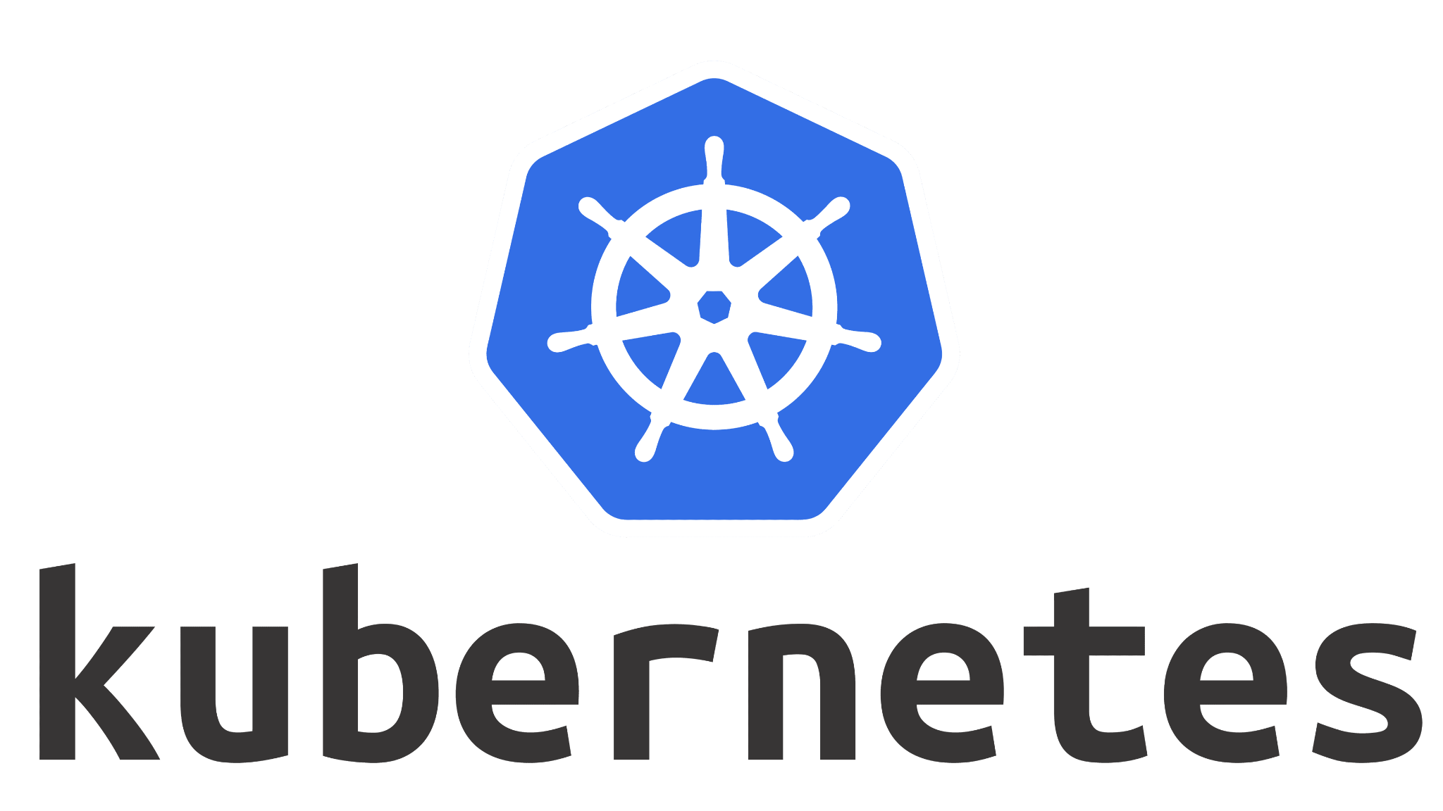
What is Kubernetes (K8s)
Kubernetes is a portable, extensible, open source platform for managing containerized workloads and services, that facilitates both declarative configuration and automation.
The name Kubernetes originates from Greek, meaning helmsman or pilot. K8s as an abbreviation results from counting the eight letters between the "K" and the "s".
Google open-sourced the Kubernetes project in 2014.
Source: https://kubernetes.io/docs/concepts/overview/
Notes:
Briefly introduce everyone to what Kubernetes is and what it can do.

Slide 6
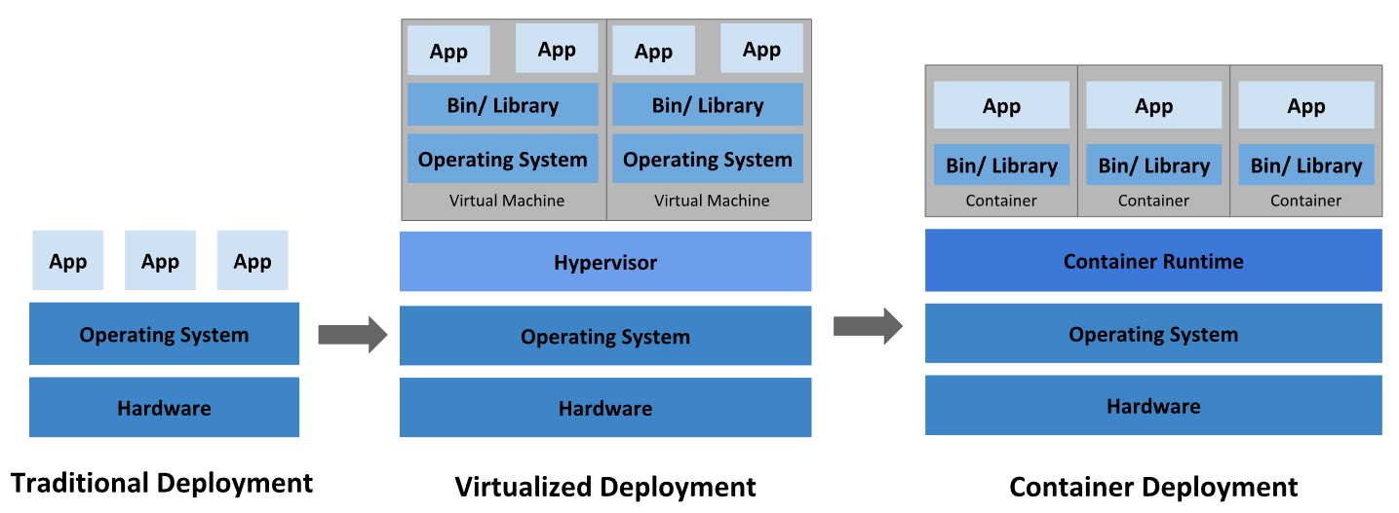
Why Kubernetes?
Source: https://kubernetes.io/docs/concepts/overview/
Notes:
Describe traditional vs. Kubernetes deployment solutions. We will see shortly why using a traditional environment listed here is not a good fit for iRODS testing.

Slide 7
iRODS Testing - Infrastructure
Docker container registry - Storage for base Docker images of operating system/version variants, some preloaded with iRODS components, test suites and testing tools.
GitHub - Source code repository. iRODS package build/push and making test requests are implemented using GitHub Actions.
RENCI K8s cluster (Sterling) - Two namespaces are assigned to iRODS (development and production).
Supporting services - Various deployments implemented on K8s for workflow management, user interfaces, web services, databases and data file systems.
Notes:
Description of the iRODS Kubernetes operation environments and deployment approach.

Slide 8
iRODS Testing - Supporting services
Job Supervisor - Workflow manager that creates and monitors K8s jobs for each data processing component.
Job Supervisor settings UI - FASTAPI web application used to administer the Job Supervisor and monitor operational state of k8s processes.
Job Supervisor database - PostgreSQL DBMS to store the Job Supervisor configurations.
iRODS Test request UI - Web interface where a development collaborator can request a testing environment and launch a test run.
Cron Jobs - Scheduled processes launched for data archival/removal and database backups.
Notes:
List of Kubernetes iRODS supporting services.

Slide 9
iRODS Testing - K8s Job supervisor
The iRODS Job supervisor is a workflow manager that has been implemented in K8s to provide:
Creates and sequences workflow job steps in order (or in parallel).
Programmatic interfaces to K8s using the K8s API.
Monitors each K8s job from start to completion.
Removes job and resource allocations on completion.
Error handling including pod retries and resource waiting.
Job characteristics are stored in a database which are adjustable via web services or UI (FASTAPI).
Notes:
List of the job supervisor features.

Slide 10
iRODS Job Supervisor workflow processing
New request impulse
iRODS Job Supervisor
iRODS Kubernetes Job
Resource management
Kubernetes worker pod(s)
Next step or
Error handling
Data persisted
to file systems, DBs and UIs
Next active request
Notes:
High-level workflow processing of the job supervisor.

Slide 11
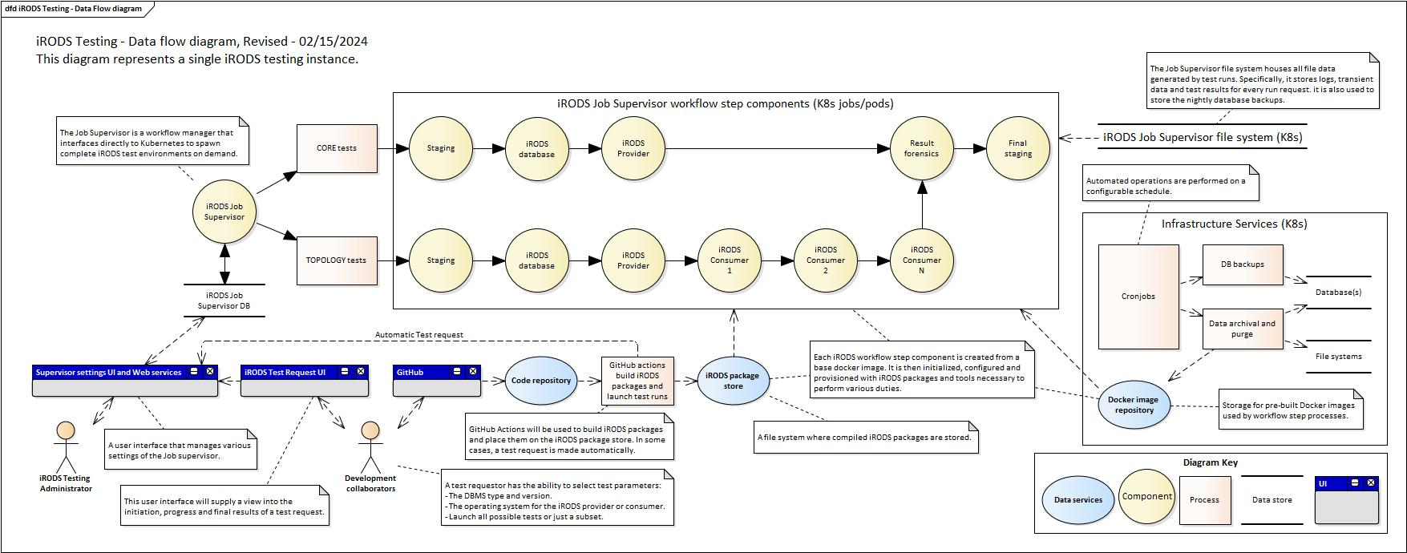
iRODS Testing - Data flow diagram
Notes:
Overview of the entire iRODS solution in pictorial format.
Red squares - High level processes
Blue ovals - Off-The-Shelf servers and services
Tan circles - RENCI developed components
Upper/lower barred - Data services
Blue/gray squares - User interfaces
Stick figures - Test admins or development collaborators

Slide 12
iRODS Job Supervisor features
Each job supervisor workflow has configuration parameters that include:
A workflow type.
A linked list of workflow process steps:
A Docker image for each step.
Run-time resource allocation (memory, cpu, ephemeral space, etc.).
NFS file system volume mounts.
Parameterized component command line(s).
Multiple containers per job/pod and parallel job steps are supported.
K8s cluster node affinity is supported.
K8s Pod failure policies are supported.
Notes:
List of job supervisor features.

Slide 13
iRODS workflow components
Initial data staging - A process that provisions the run with a file system data store and pod initialization scripts into the K8s working environment.
iRODS Database - A database whose type and version is specified by the test requestor.
iRODS Provider - A iRODS provider deployment that is provisioned with various iRODS packages and tests to perform.
iRODS Consumer(s) - A iRODS consumer deployment that is provisioned with various iRODS packages and tests to perform.
Test result forensics - A process that collects test results and processes them for return back to the requestor.
Final data staging - A process that moves finalized data, updates databases, and removes intermediate data.
Notes:
These are the iRODS K8s workflow components that comprise a testing workflow.

Slide 14
The Positive effect
Our initial proof-of-concept has shown that creating, provisioning and testing iRODS can be realized using Kubernetes.
Kubernetes has allowed us to be able to simultaneously execute multiple test suites and topologies. Although we have seen marginal performance improvements, the time from ‘development to test results’ has been dramatically reduced.
The iRODS Development team appreciates the ‘hands-free’ testing and is looking forward to other proposed features like the witnessing the state of running tests in real-time.

Slide 15
Acknowledgements. Questions?
iRODS Team
Player 1
Player 2
Etc…
Scan to access today’s slides

Slide 16
Appendix - Various Links
iRODS Helm charts: https://github.com/irods/irods_k8s
iRODS Job supervisor: https://github.com/irods-contrib/iRODS-K8s-Supervisor
iRODS Job Supervisor Settings User interface: https://github.com/irods-contrib/iRODS-K8s-Settings
iRODS Staging: https://github.com/irods-contrib/iRODS-K8s-Staging
iRODS Forensics: https://github.com/irods-contrib/iRODS-K8s-Forensics
iRODS Test Request UI: https://github.com/PhillipsOwen/irods-testrequest-ui
iRODS Data flow diagram:
iRODS Job supervisor process diagram:
Notes:
A list of places used for the testing environment implementation and components

